Slide 1
Evaluating the Julia package CellBasedModels.jl
Marko Korb
12.11.2024

Slide 2
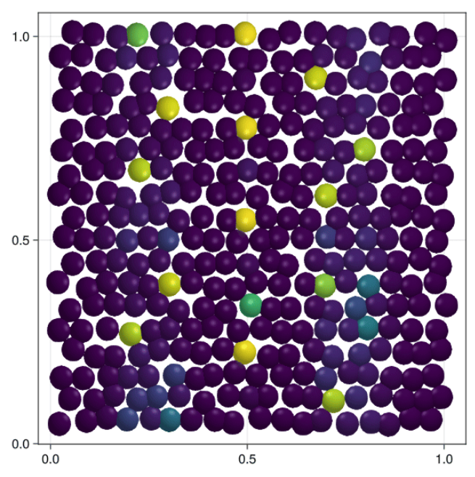
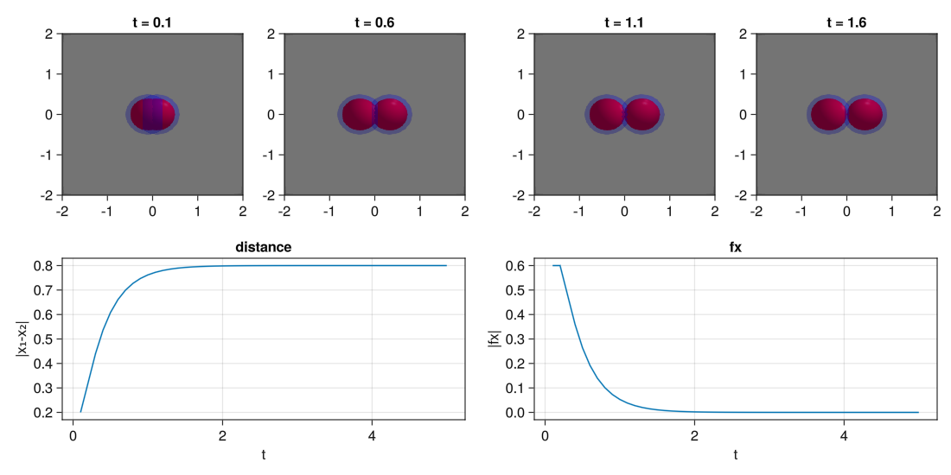
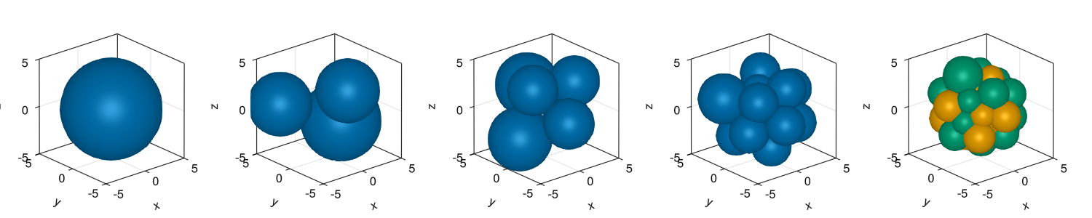
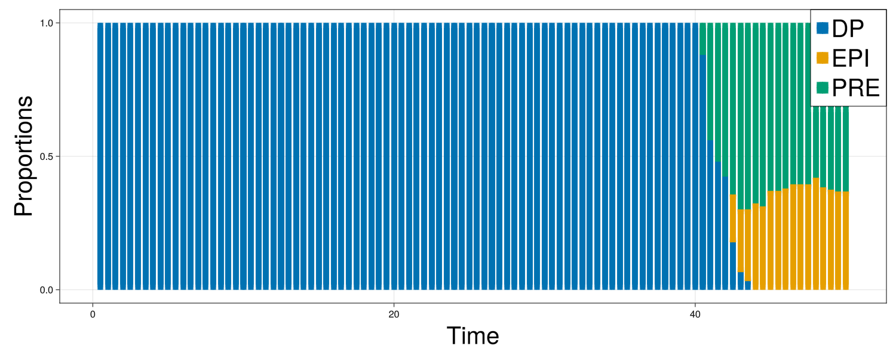
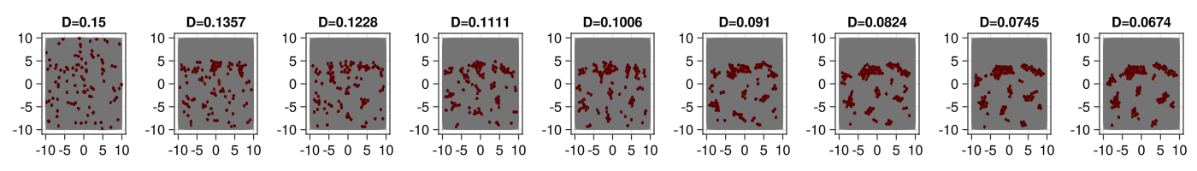
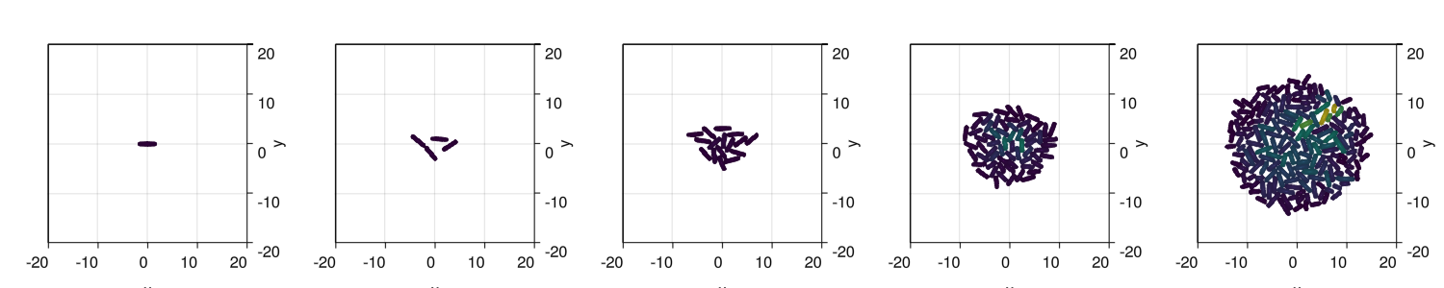
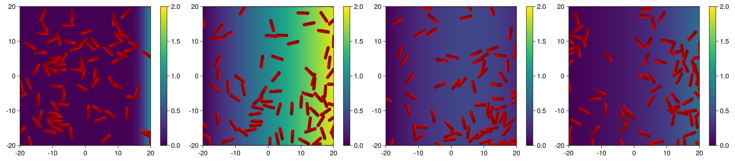
Patterning
ICM development
Particle aggragation
Bacterial colony growth
Bacterial chemotaxis

Slide 3
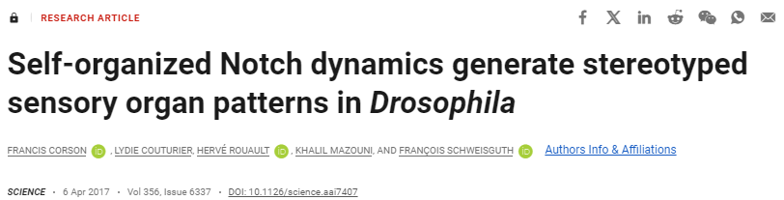
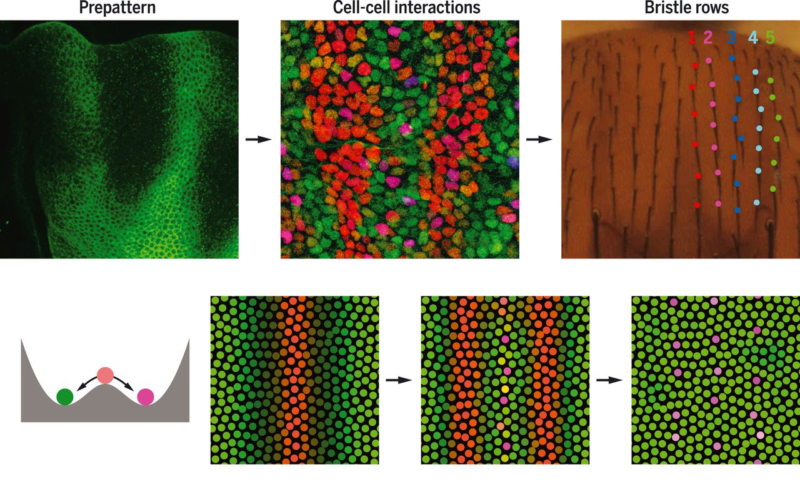
Patterning

Slide 4
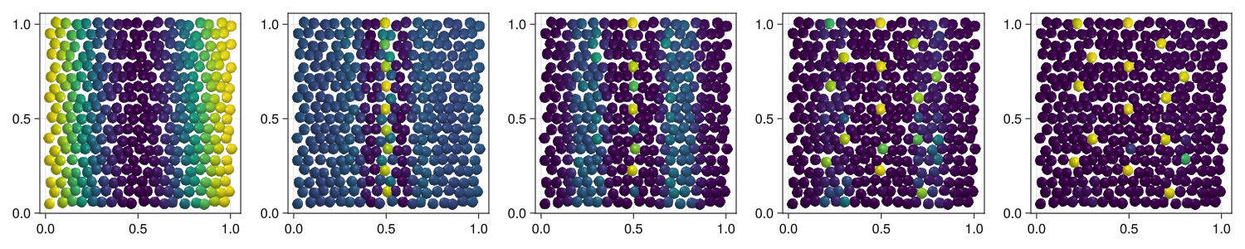
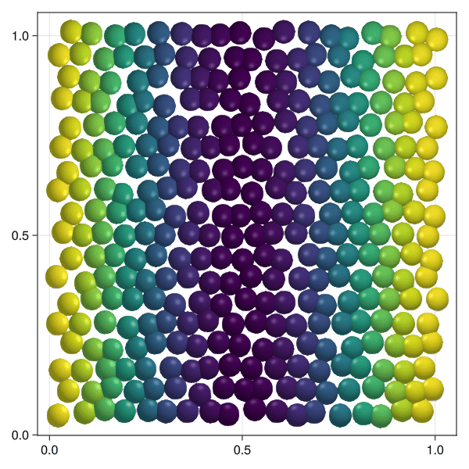
Patterning

Slide 5
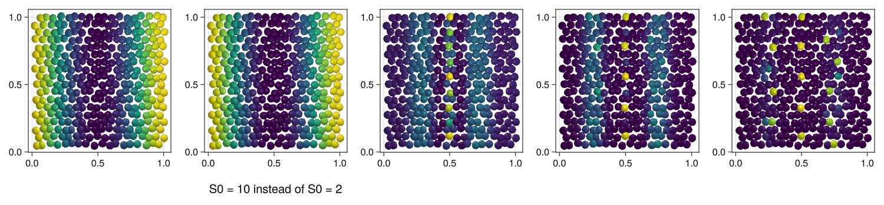
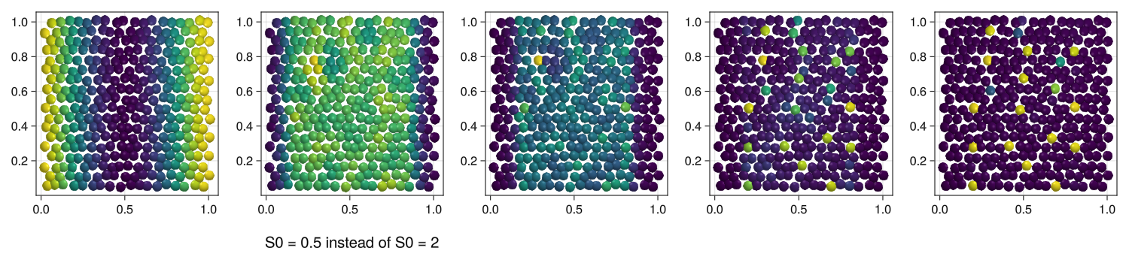
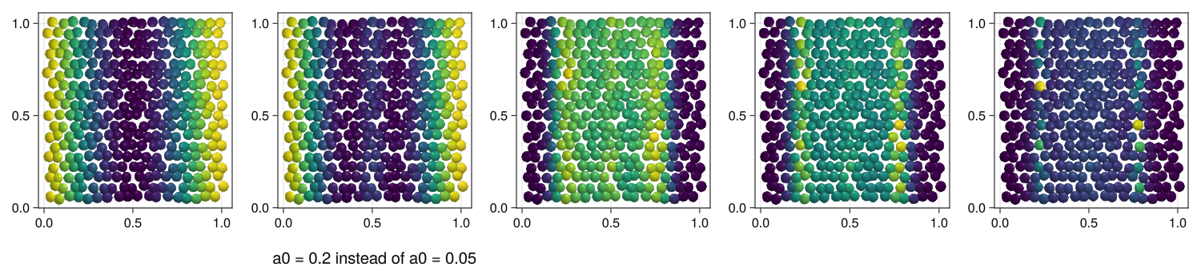
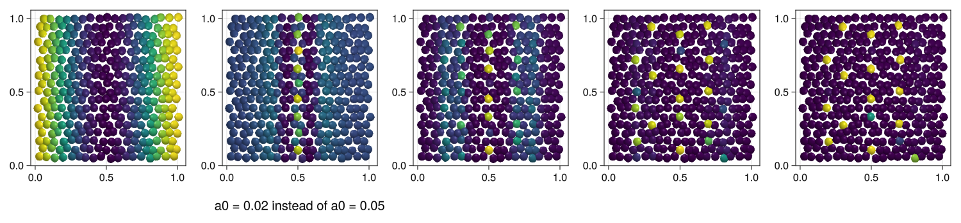
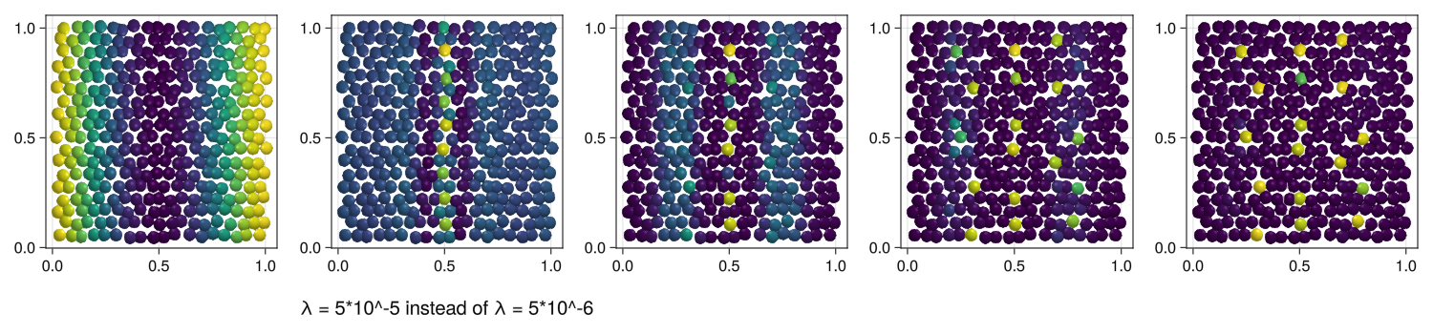
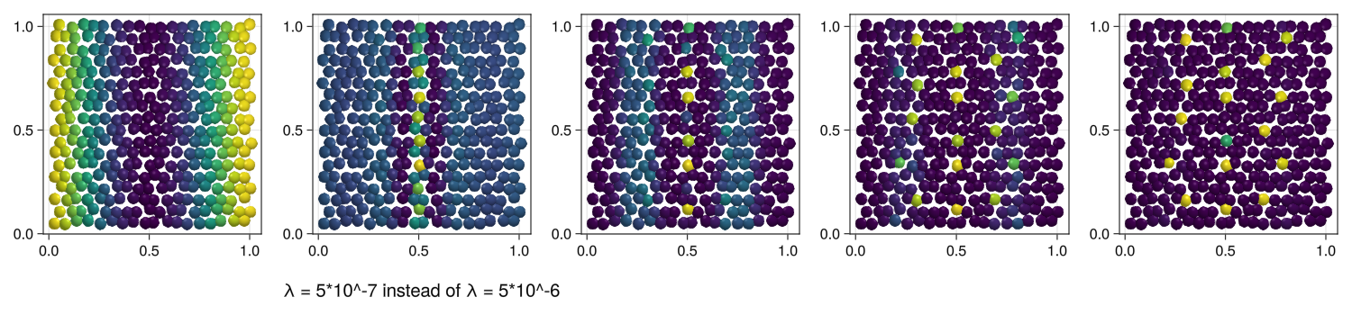
Patterning
S0 = May represent an initial or maximum value for a morphogen source or sink
a0 = Initial concentration or starting value of the morphogen substance
λ = Dispersion rate or decay factor for the morphogen gradient

Slide 6
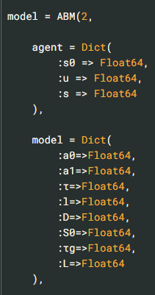
Patterning
Defining complex functions and their many parameters can be daunting at first with no prior knowledge about ABMs
It is hard to play around with the parameters as they are not explained
fσ(x) = (1+tanh(2*x))/2
fs0(x,t,l,S0,τg,L) = S0*fσ(1-t/τg)*(exp(-x^2/(2*L^2))+exp(-(1-x)^2/(2*L^2))) + fσ(t/τg-1)*(exp(-x^2/(2*l^2))+exp(-(1-x)^2/(2*l^2)))

Slide 7
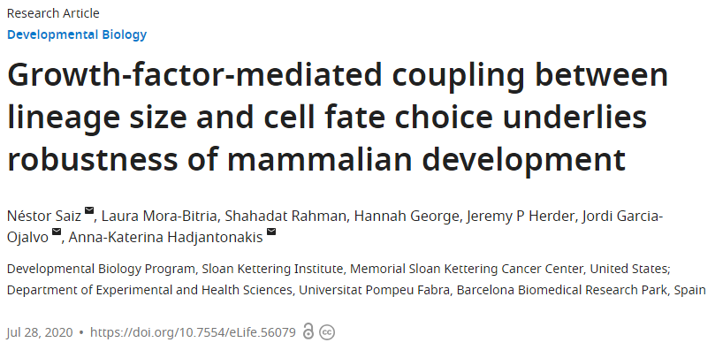
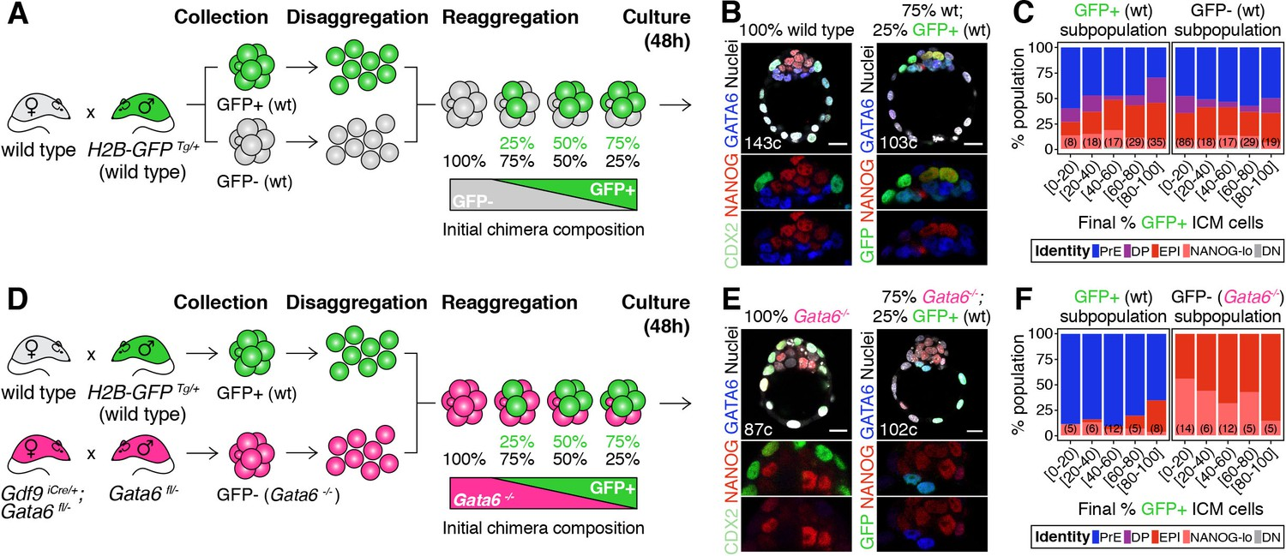
ICM development

Slide 8
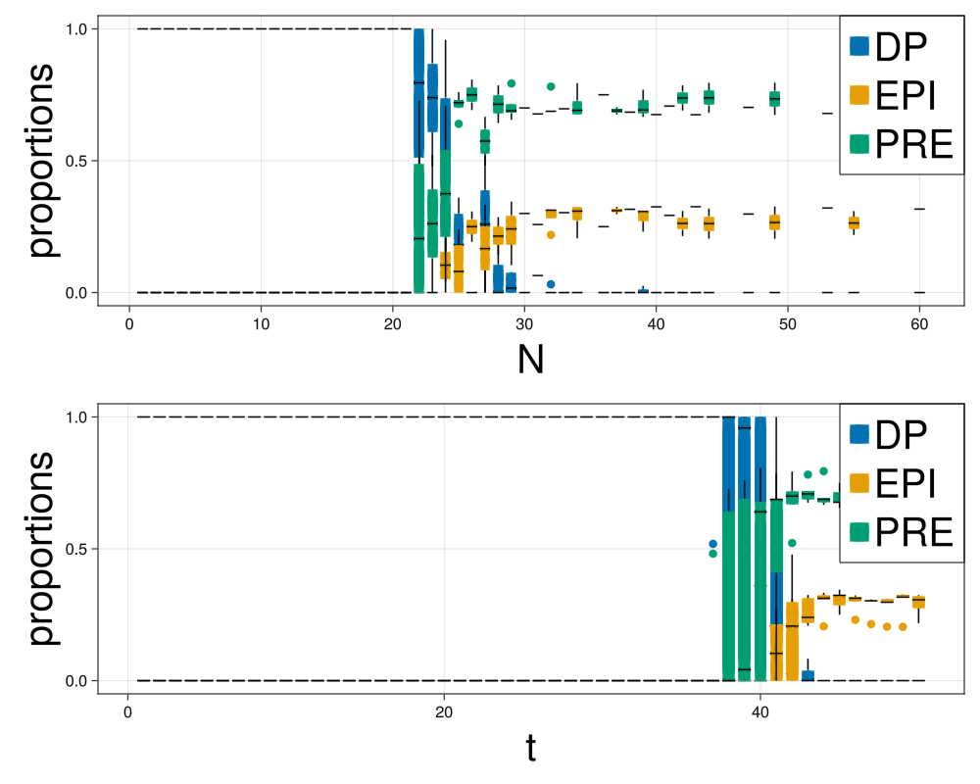
ICM development

Slide 9
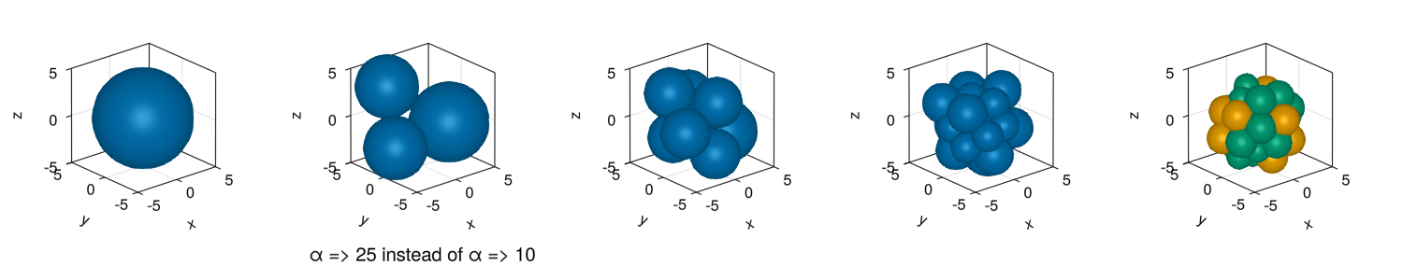
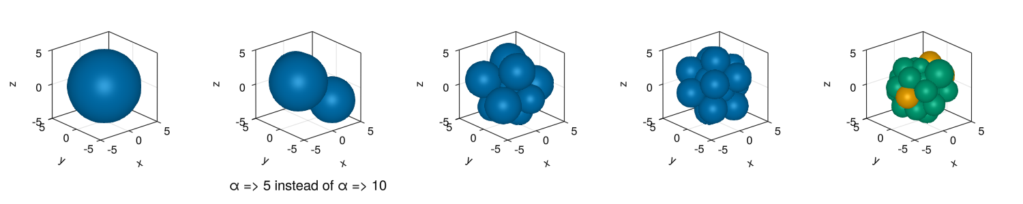
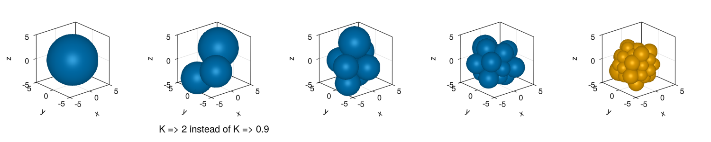
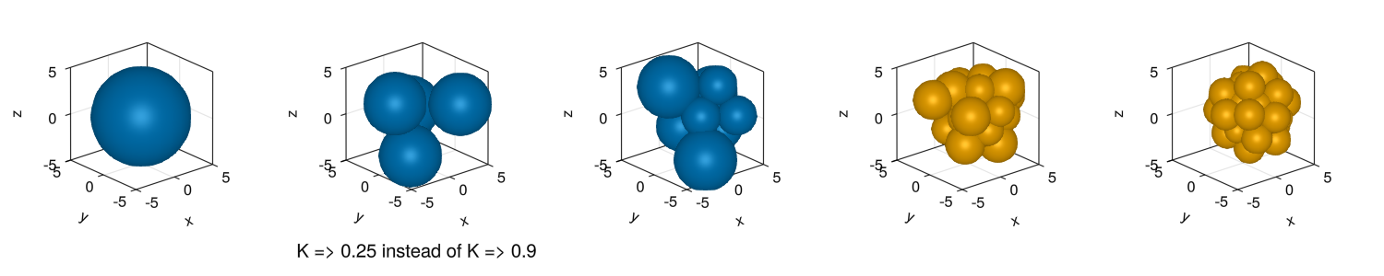
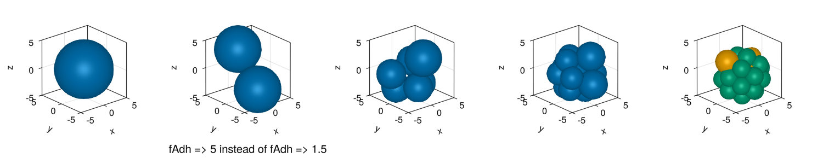
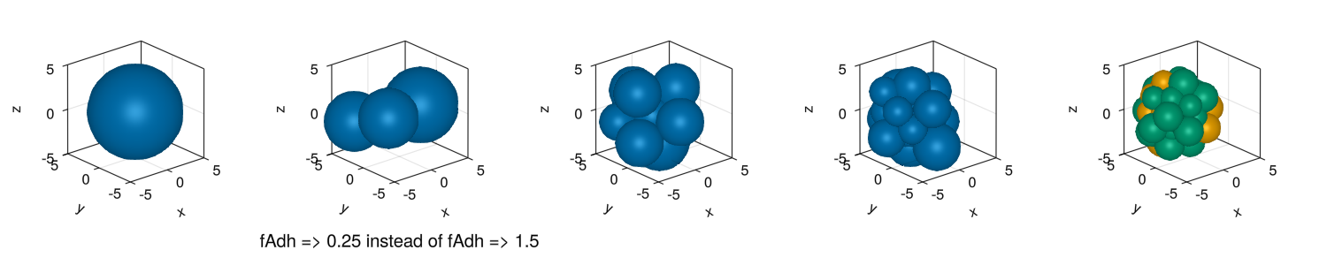
ICM development
α = Possibly a growth rate or a coefficient related to interaction strength between cells
K = Likely refers to a carrying capacity, the maximum population size that the environment can sustain
fAdh = Likely an adhesion force parameter, representing the strength of the adhesive interactions between cells

Slide 10
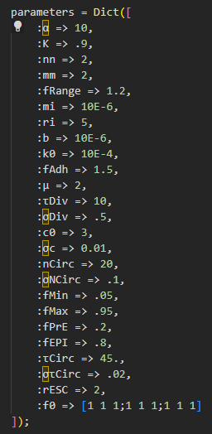
ICM development
I could not complete the example as they were using a .csv file that was not provided
A lot of parameters that are not explained

Slide 11
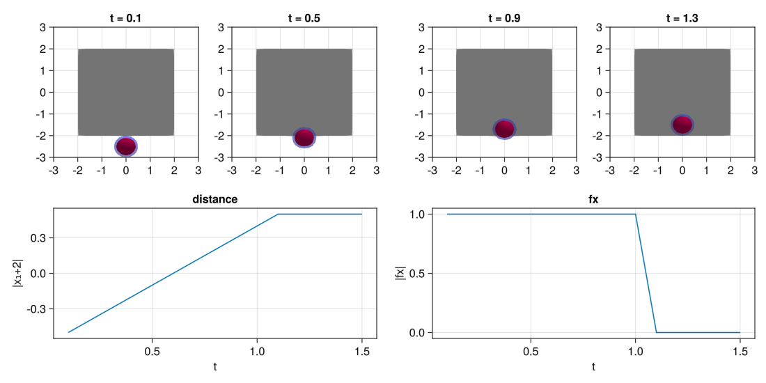
Particle aggragation

Slide 12
Particle aggragation

Slide 13
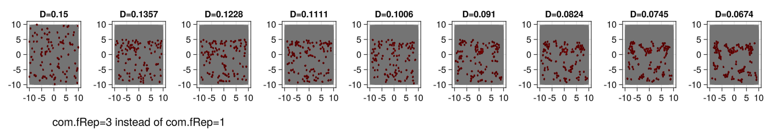
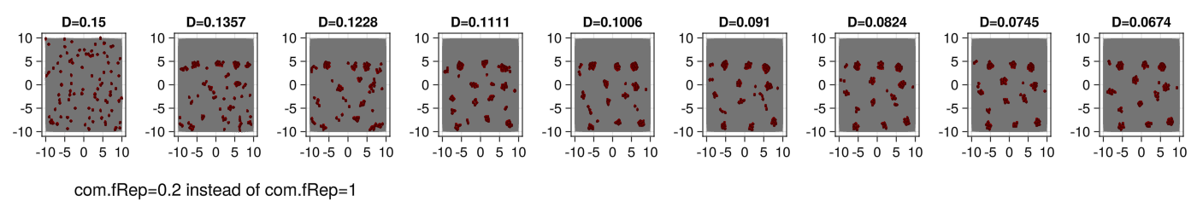
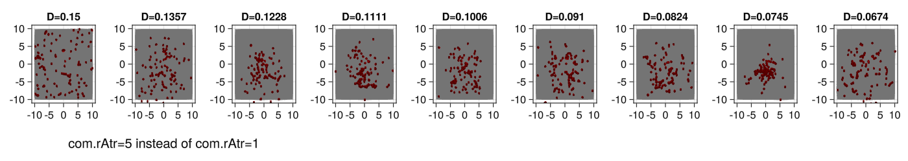
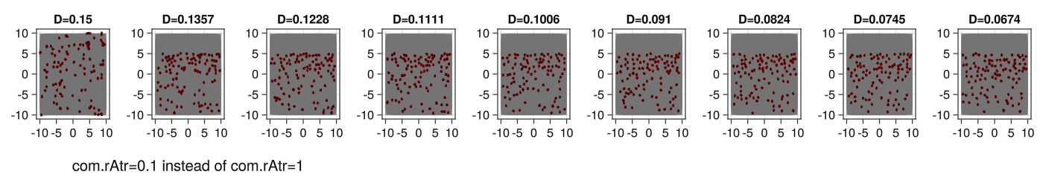
Particle aggragation
fRep = Force of repulsion
rAtr = Radius of attraction

Slide 14
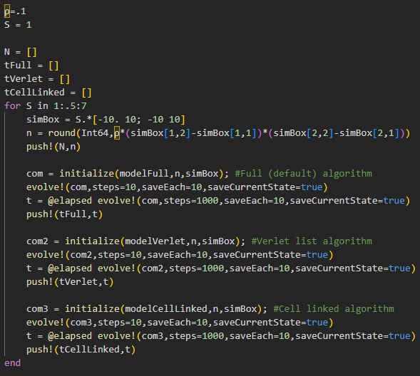
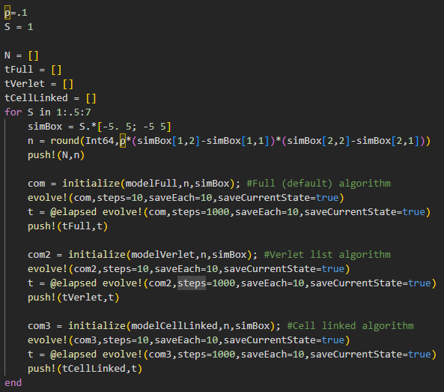
Particle aggragation
„nested task error: BoundsError“ in example
→ Had to use a smaller simBox
Again parameters…

Slide 15
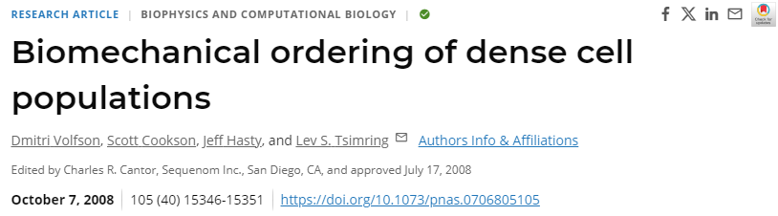
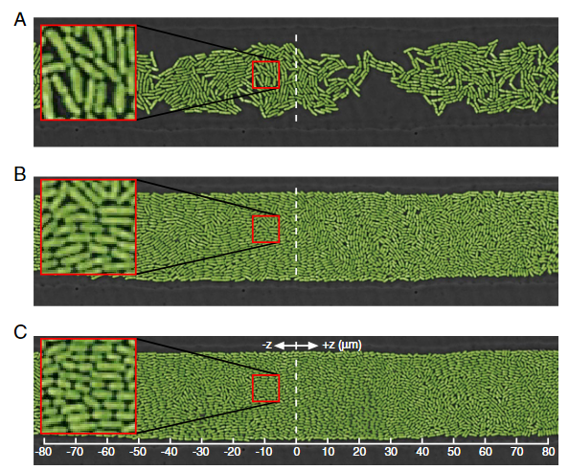
Bacterial colony growth

Slide 16
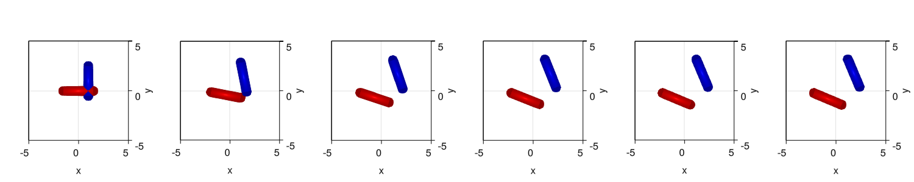
Bacterial colony growth

Slide 17
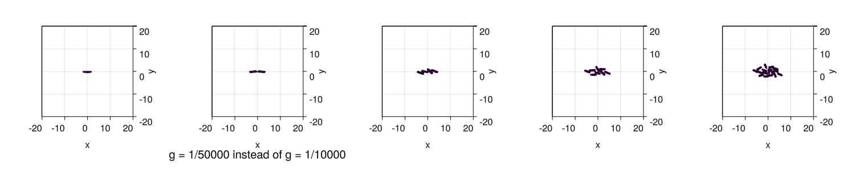
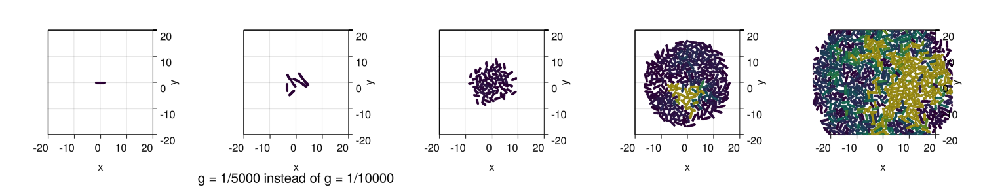
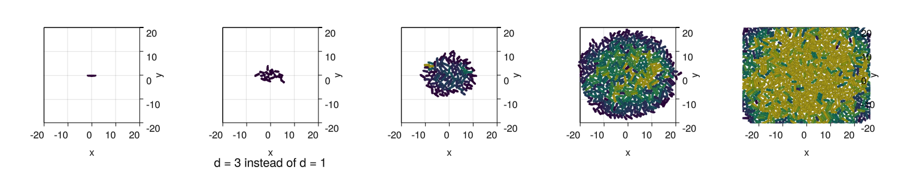
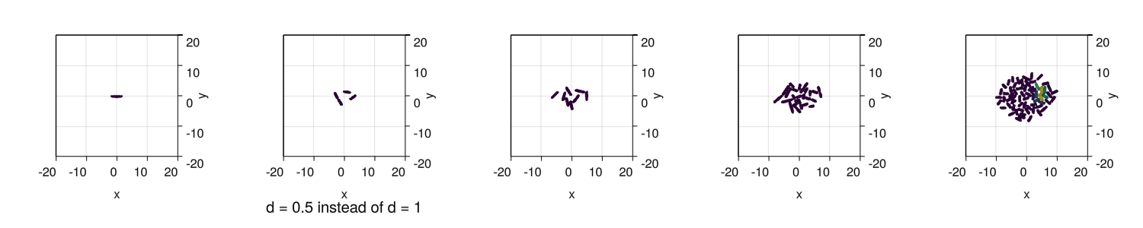
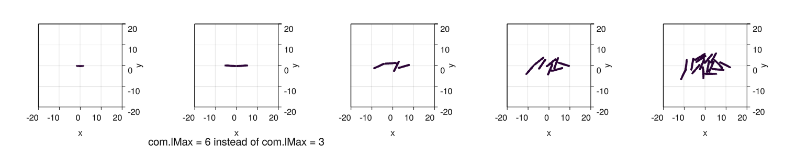
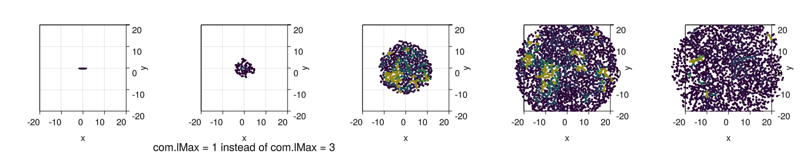
Bacterial colony growth
g = A growth scaling factor, likely setting a reference growth rate for the bacteria
d = Could represent a diffusion or density characteristic
lMAX = The maximum allowable cell length

Slide 18
Bacterial colony growth
I could not initialize the community because the platform „GPU“ could not be defined
→ I had to use CPU instead
Parameters

Slide 19
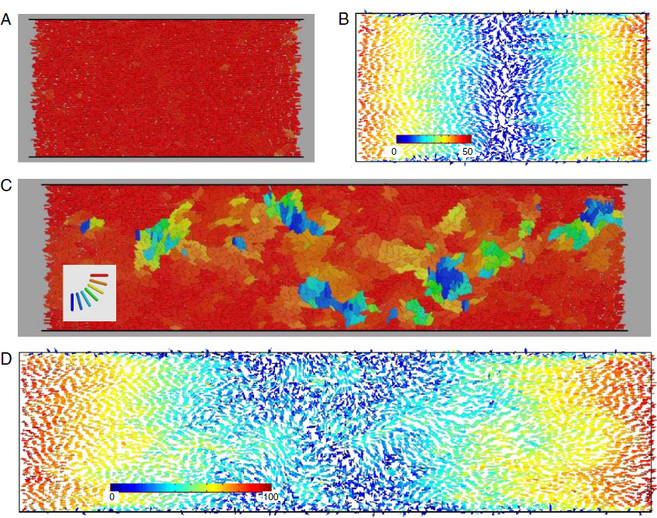
Bacterial chemotaxis

Slide 20
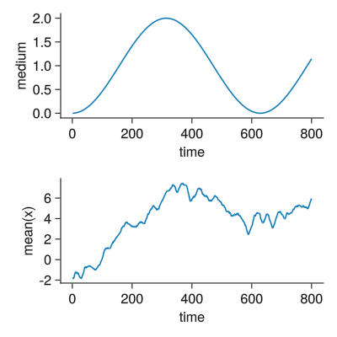
Bacterial chemotaxis

Slide 21
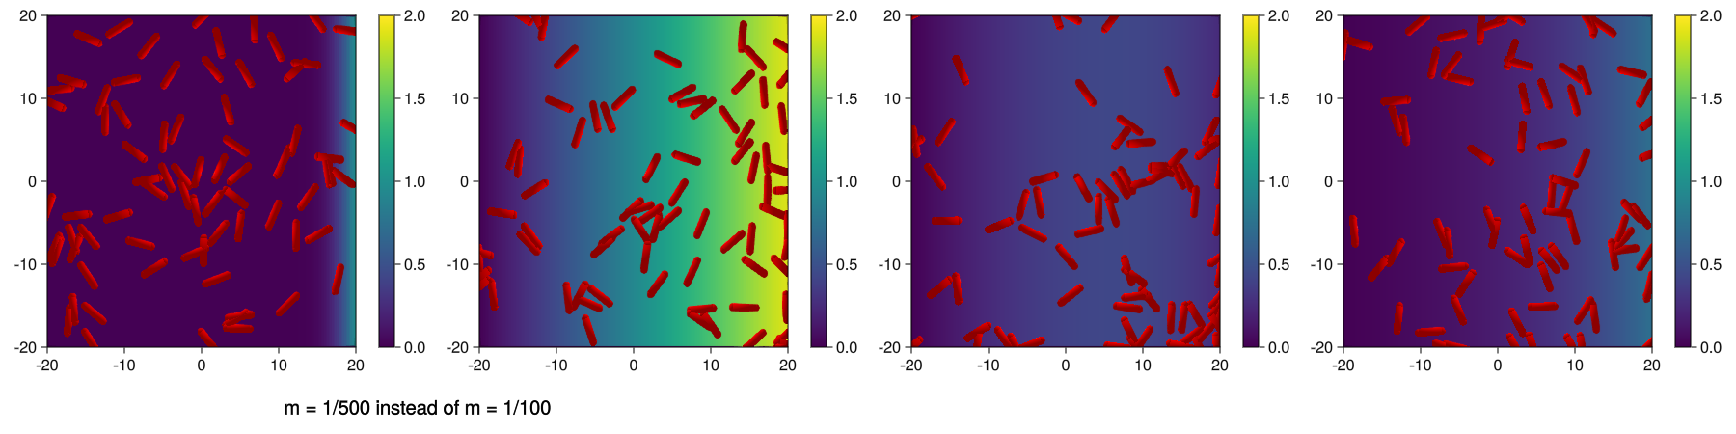
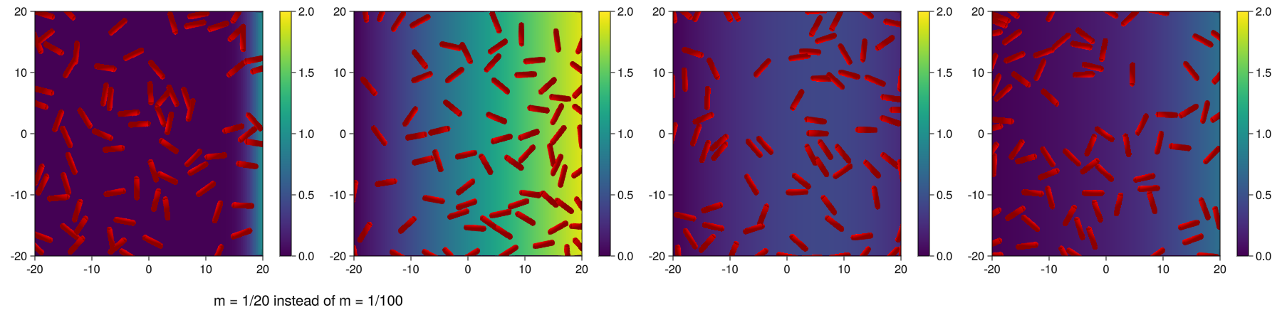
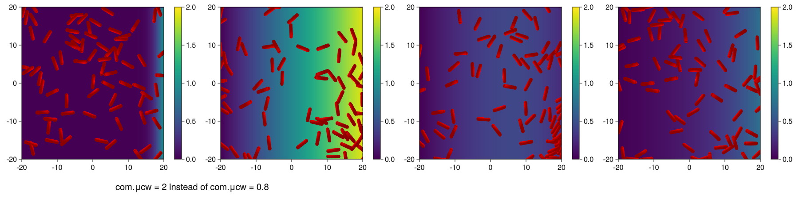
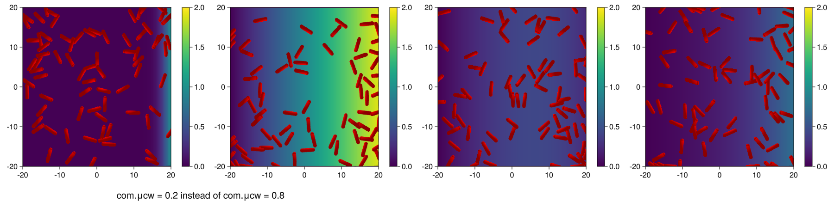
Bacterial chemotaxis
m = A mass scaling factor, potentially representing the mass of the bacteria
μcw = The cell-wall interaction rate

Slide 22
Bacterial chemotaxis
Function „plotRods2D“ was not defined even though it is listed in the documentation
→ I had to copy the code from the documentation and define the function in my code
Parameters are not explained
Changing the parameters does not seem to have any impact(?)

Slide 23
General
The package did not seem to work with Julia 1.11
→ Julia 1.9 had to be used
No real commit for more than a year
It requires prior knowledge about ABMs
The examples alone made it difficult to understand how ABMs work and were not able to explain what is happening

Slide 24
Opinions of group members
Looks like it is not suitable for a grid approach
Could be hard (or a lot of work) to transfer existing networks/models
In principle the package looks promising
Getting started using the package is too difficult without prior knowledge about ABMs (and their math)
If you can‘t simulate multiple agents / cell types in one simulation and/or if you can‘t simulate vertex models there is not much added value in using the package
Implemented functions / macros like evolve!, @addAgent or @removeAgent are convenient
A lot of groundwork for ABMs is implemented already
Performance could be worse than in Agents.jl
No „live view“ of simulations like in Agents.jl
Focus on cells in their medium could make it better than Agents.jl

Slide 25
Conclusion
Although the package looks promising and has some convenient features, it lacks better onboarding as well as support for newer Julia versions. Future proof? → A lack of commits could indicate that the package maybe has no real future.
Based on all of this I would not really recommend using the package as standard in the group.

Slide 26
Thank you ☺

Slide 27

Patterning

Slide 28

ICM development

Slide 29

Particle aggragation

Slide 30

Bacterial colony growth

Slide 31

Bacterial chemotaxis

Slide 32


Slide 33

https://github.com/MarkoKorb/CellBasedModelsF1/

